Slide 1


PERI-IMPLANTITIS
RUNGTA COLLEGE OF DENTAL SCIENCES AND RESEARCH,BHILAI
PRESENTED BY:
Dr Sonika Bodhi
Reader
Dept. of Periodontology

Slide 2
SPECIFIC LEARNING OBJECTIVES
CORE AREAS | DOMAIN | CATEGORY
Introduction | Affective | Desire to know
Classification | Cognitive | Nice to know
Etiopathogenesis | Cognitive | Must to know
Risk factors | Cognitive | Must to know
Diagnosis | Cognitive | Must to know
Management | Cognitive | Must to know

Slide 3
CONTENTS
Introduction
Classification
Etiopathogenesis
Risk factors
Diagnosis
Management
Summary
References

Slide 4

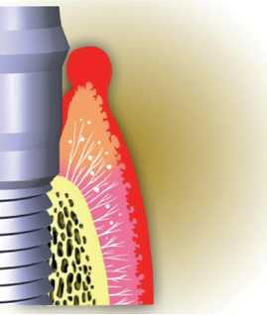
INTRODUCTION
Peri-implant disease following successful integration of an endosseous implant is the result of an imbalance between bacterial load and host defence.

Slide 5
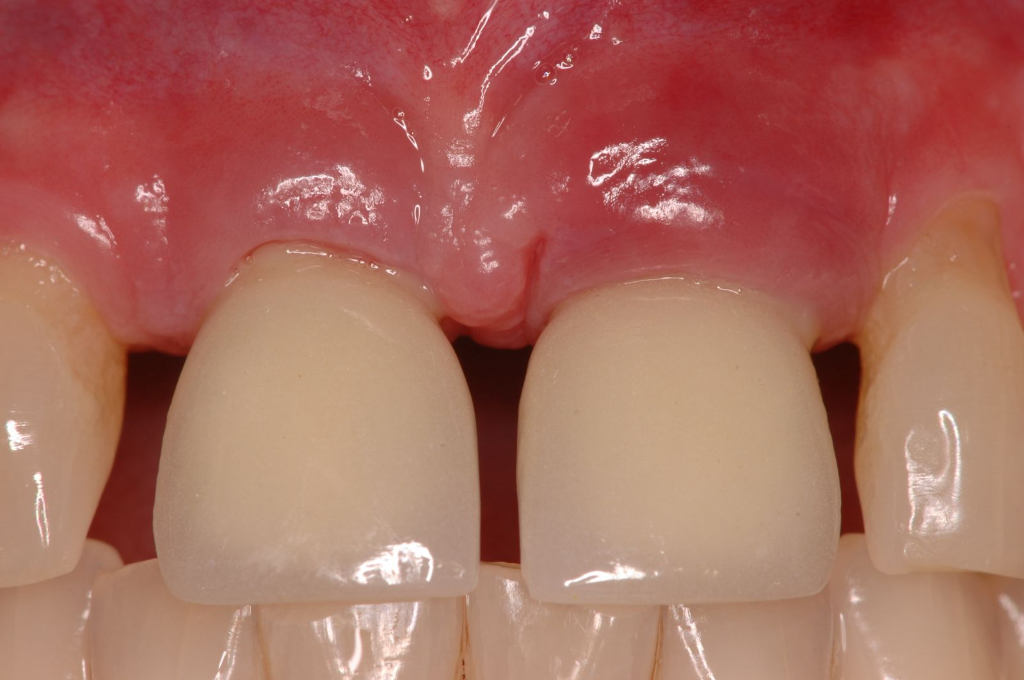
At the first European Workshop on Periodontology:
Peri-implant mucositis was defined as reversible inflammatory changes of the peri-implant soft tissues without any bone loss.

Slide 6
The term peri-implantitis was introduced by Mombelli et al. (1987), who in a study on the microbiota at implants with and without bone loss concluded that “peri-implantitis can be regarded as a site specific infection which yields many features in common with chronic periodontitis”.

Slide 7
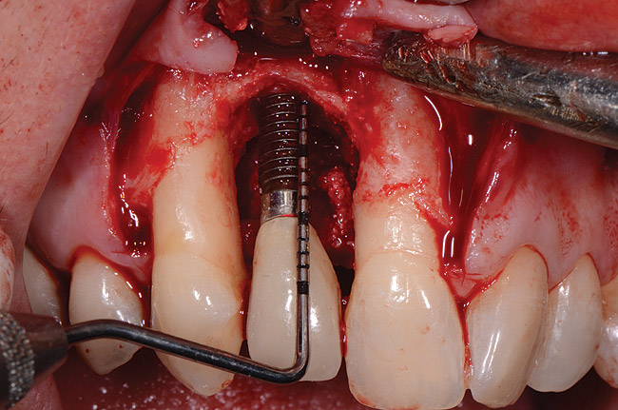
Peri-implantitis was defined as an inflammatory process affecting the tissues around an osseointegrated implant in function, resulting in loss of supporting bone.

Slide 8
Classification of peri-implantitis.......Forum SJ and Rosen PS 2012
Early | PD ≥ 4 mm (bleeding and/or suppuration on probing) Bone loss < 25% of the implant length
Moderate | PD ≥ 6 mm (bleeding and/or suppuration on probing) Bone loss 25% to 50% of the implant length
Advanced | PD ≥ 8 mm (bleeding and/or suppuration on probing) Bone loss > 50% of the implant length

Slide 9
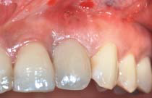
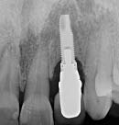
EARLY: PD ≥ 4 mm (bleeding and/or suppuration on probing) Bone loss < 25% of the implant length

Slide 10
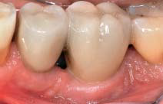
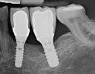
MODERATE: PD ≥ 6 mm (bleeding and/or suppuration on probing) Bone loss 25% to 50% of the implant length

Slide 11
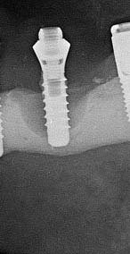
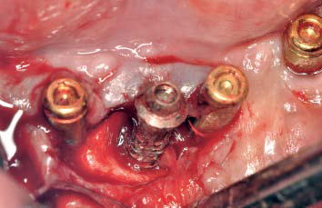
ADVANCED: PD ≥ 8 mm (bleeding and/or suppuration on probing) Bone loss > 50% of the implant length

Slide 12
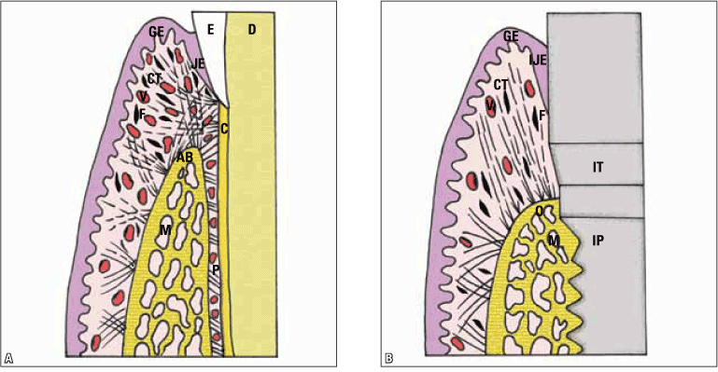
Normal periodontium/peri-implant mucosa

Slide 13
Etiopathogenesis:
Due to the reduced vascularization and parallel orientation of the collagen fibres, peri-implant tissues are more susceptible for inflammatory disease than periodontal tissues.
This phenomenon can be verified immunohistochemically through increased formation of inflammatory infiltrate, nitric oxide, VEGF, lymphocytes, leukocytes.

Slide 14
An accumulation of microbes in plaque at the peri-implant or mucosal margin causes a local inflammation, which is a complex reaction of the body in response to infectious agents.
Inflammatory cells such as macrophages, neutrophil granulocytes, lymphocytes and plasma cells, provoke considerable tissue damage.
The degradation of connective tissue is followed by bone destruction, which marks the borderline between periimplant mucositis and peri-implantitis.

Slide 15
Two primary etiologic factors in peri-implant marginal bone loss:
Bacterial infection
Biomechanical overload

Slide 16
MICROBIOLOGIC FINDINGS
Healthy peri-implant pockets are characterized by high proportions of coccoid cells, a low ratio of anaerobic/aerobic species, a low number of Gram-negative species and low detection frequencies for bacteria associated with periodontitis.

Slide 17
MICROBIOLOGIC FINDINGS
Quirynen et al. (2006), studied early microbial colonization of the “pristine” peri-implant pocket and reported that a complex microbiota was established within a week after abutment insertion.

Slide 18
Peri-implantitis is a poly-microbial anaerobic infection.
Prevotella intermedia, Prevotella nigrescens, Streptococcus constellatus, Aggregatibacter actinomycetemcomitans, Porphyromonas gingivalis, Treponema denticola and Tannerella forsythia.

Slide 19
In contrast to periodontitis, peri-implantitis lesions harbor bacteria that are not part of the typical periodontopathic microbiota.
In particular, Staphylococcus aureus appears to play a predominant role for the development of a peri-implantitis. This bacterium shows an high affinity to titanium...........Salvi GE et al 2008

Slide 20
Biomechanical Overload
Bone loss at the coronal aspect of implants can result from biomechanical overloading and the resultant microfractures at the coronal aspect of the implant-bone interface.

Slide 21
The loss of osseointegration in this region results in apical down growth of epithelium and connective tissue. The speed and degree of loss of implant-bone contact depends upon the frequency and magnitude of the occlusal loading as well as superimposed bactrerial invasion.

Slide 22
The role of over loading is likely to increase in four clinical situations:
The implant is placed in poor quality bone.
The implant’s position
The patient has a pattern of heavy occlusal function associated with parafunction.
The prosthetic superstructure does not fit the implants precisely.

Slide 23
RISK FACTORS
Smoking with additional significantly higher risk of complications in the presence of an positive combined IL-1 genotype polymorphism.
History of periodontitis.
Poor oral hygiene
Systemic diseases (e.g. diabetes mellitus, cardiovascular disease, immunosuppression).

Slide 24
RISK FACTORS
Iatrogenic causes (e.g. “cementitis”).
Soft tissue defects or poor-quality soft tissue at the area of implantation (e.g. lack of keratinized gingiva).
History of one or more failures of implants.
Alcohol consumption
Implant surfaces

Slide 25
DIAGNOSIS
Peri-implant probing
Bleeding on probing
PICF
Microbial testing
Radiographic evaluation
Suppuration
Mobility

Slide 26
TREATMENT
The indication for the appropriate treatment strategy has been demonstrated in patient studies leading to the development of the “cumulative interceptive supportive therapy (CIST)” concept. In 2004 it was modified and called AKUT-concept by Lang et al.

Slide 27
The basis of this concept is a regular recall of the implanted patient and repeated assessment of plaque, bleeding, suppuration, pockets and radiological evidence of bone loss.

Slide 28
Stage | Result | Therapy
 | Pocket depth (PD) < 3 mm, no plaque or bleeding | No therapy
A | PD < 3 mm, plaque and/ or bleeding on probing | Mechanically cleaning, polishing, oral hygiene instructions

Slide 29
Surgical therapy
Stage | Result | Therapy
B | PD 4-5 mm, radiologically no bone loss. | Mechanically cleaning, polishing, oral hygienic instructions plus local antiinfective therapy (e.g. CHX)
C | PD > 5 mm, radiologically bone loss < 2 mm | Mechanically cleaning, polishing, microbiological test, local and systemic antiinfective therapy

Slide 30
Stage | Result | Therapy
D | PD > 5 mm, radiologically bone loss > 2 mm | Resective or regenerative surgery

Slide 31
Nonsurgical therapy
  Local debridement
  Implant surface decontamination
  Anti-infective therapy
  Laser-assisted treatment of peri-implantitis
  Photodynamic therapy
Surgical therapy

Slide 32
Surgical therapy
The surgical therapy combines the concepts of the already mentioned non-surgical therapy with those of resective and/or regenerative procedures.
Classification of the morphology of peri-implant lesions was important for choosing a reliable type of bone regeneration and for prognosis of surgical therapy of periimplantitis.

Slide 33
SUMMARY
Prognosis of the affected implant will be contingent upon early detection and treatment of peri-implant mucositis and peri-implantitis.
Differentiating peri-implantitis with and without pus formation is an important criteria that influences the outcome of non-surgical and surgical therapy.

Slide 34
REFERENCES
Newman MG, Takei HH, Klokkevold PR, Carranza FA. Carranza’s clinical periodontology, 10th ed. Saunders Elsevier; 2007.
Lindhe J, Lang NP and Karring T. Clinical Periodontology and Implant Dentistry. 6th ed. Oxford (UK): Blackwell Publishing Ltd.; 2015.
Newman MG, Takei HH, Klokkevold PR, Carranza FA. Carranza’s clinical periodontology, 13th ed. Saunders Elsevier; 2018.

